Slide 1
Data Mining
M2: Data Preprocessing

Slide 2
2.1 Data Preprocessing Concepts
Source Courtesy: Some of the contents of this PPT are sourced from materials provided by publishers of prescribed books

Slide 3
Preprocessing Objectives
To improve data quality
To modify data to better fit specific data mining technique

Slide 4
Major Tasks in Data Preprocessing
Data cleaning
Fill in missing values, smooth noisy data, identify or remove outliers, and resolve inconsistencies
Data integration
Integration of multiple databases, data cubes, or files
Data reduction
Dimensionality reduction
Numerosity reduction
Data compression
Data transformation and data discretization
Normalization
Concept hierarchy generation

Slide 5
Data Quality: Multidimensional View
Measures for data quality: A multidimensional view
Accuracy: correct or wrong, accurate or not
Completeness: not recorded, unavailable, …
Consistency: some modified but some not, dangling, …
Timeliness: timely update?
Believability: how trustable the data are correct?
Interpretability: how easily the data can be understood?

Slide 6
Data Quality
What kinds of data quality problems?
How can we detect problems with the data?
What can we do about these problems?
Examples of data quality problems:
Noise and outliers
missing values
duplicate data

Slide 7
Data Cleaning
Data in the Real World Is Dirty: Lots of potentially incorrect data, e.g., instrument faulty, human or computer error, transmission error
incomplete: lacking attribute values, lacking certain attributes of interest, or containing only aggregate data
e.g., Occupation = “ ” (missing data)
noisy: containing noise, errors, or outliers
e.g., Salary = “−10” (an error)
inconsistent: containing discrepancies in codes or names, e.g.,
Age = “42”, Birthday = “03/07/2010”
Was rating “1, 2, 3”, now rating “A, B, C”
discrepancy between duplicate records
Intentional (e.g., disguised missing data)
Jan. 1 as everyone’s birthday?

Slide 8
Incomplete (Missing) Data
Data is not always available
E.g., many tuples have no recorded value for several attributes, such as customer income in sales data
Missing data may be due to
equipment malfunction
inconsistent with other recorded data and thus deleted
data not entered due to misunderstanding
certain data may not be considered important at the time of entry
not register history or changes of the data
Missing data may need to be inferred

Slide 9
How to Handle Missing Data?
Ignore the tuple: usually done when class label is missing (when doing classification)—not effective when the % of missing values per attribute varies considerably
Fill in the missing value manually: tedious + infeasible?
Fill in it automatically with
a global constant : e.g., “unknown”, a new class?!
the attribute mean
the attribute mean for all samples belonging to the same class: smarter
the most probable value: inference-based such as Bayesian formula or decision tree

Slide 10
Noisy Data
Noise: random error or variance in a measured variable
Incorrect attribute values may be due to
faulty data collection instruments
data entry problems
data transmission problems
technology limitation
inconsistency in naming convention
Other data problems which require data cleaning
duplicate records
incomplete data
inconsistent data
10
Notes:
10

Slide 11
How to Handle Noisy Data?
Binning (also used for discretization)
first sort data and partition into (equal-frequency) bins
then one can smooth by bin means, smooth by bin median, smooth by bin boundaries, etc.
Binning methods smooth a sorted data value by consulting its "neighborhood," that is, the values around it, i.e. they perform local smoothing.
Regression
smooth by fitting the data into regression functions
Clustering
detect and remove outliers
Combined computer and human inspection
detect suspicious values and check by human (e.g., deal with possible outliers)
Notes:
Enrich using data integration research!!

Slide 12
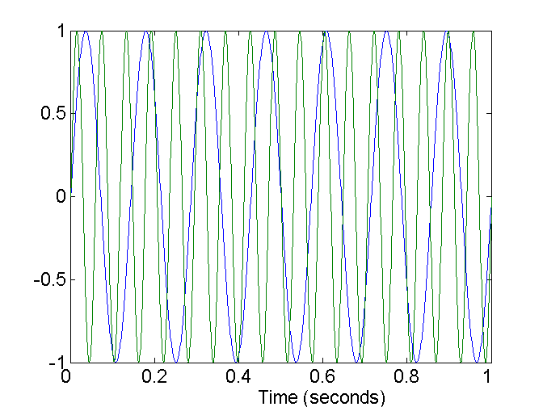
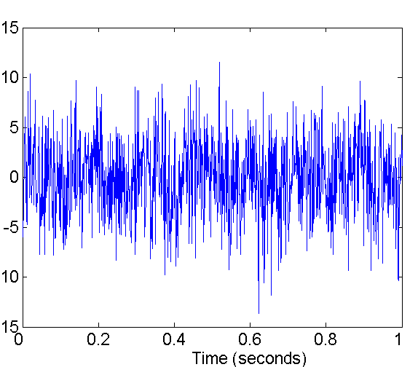
Noise
Noise refers to modification of original values
Examples: distortion of a person’s voice when talking on a poor phone and “snow” on television screen
Two Sine Waves
Two Sine Waves + Noise

Slide 13
Duplicate Data
Data set may include data objects that are duplicates, or almost duplicates of one another
Major issue when merging data from heterogeous sources
Examples:
Same person with multiple email addresses
Data cleaning
Process of dealing with duplicate data issues

Slide 14
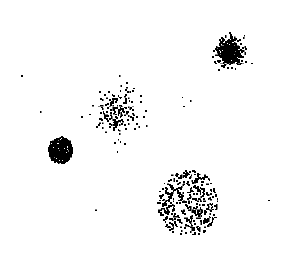
Outliers
Outliers are data objects with characteristics that are considerably different than most of the other data objects in the data set

Slide 15
Data Cleaning as a Process
Data discrepancy detection
Use metadata (e.g., domain, range, dependency, distribution)
Check field overloading
Check uniqueness rule, consecutive rule and null rule
Use commercial tools
Data scrubbing: use simple domain knowledge (e.g., postal code, spell-check) to detect errors and make corrections
Data auditing: by analyzing data to discover rules and relationship to detect violators (e.g., correlation and clustering to find outliers)
Data migration and integration
Data migration tools: allow transformations to be specified
ETL (Extraction/Transformation/Loading) tools: allow users to specify transformations through a graphical user interface
Integration of the two processes
Iterative and interactive (e.g., Potter’s Wheels)

Slide 16
Prescribed Text Books
 | Author(s), Title, Edition, Publishing House
T1 | Tan P. N., Steinbach M & Kumar V. “Introduction to Data Mining” Pearson Education
T2 | Data Mining: Concepts and Techniques, Third Edition by Jiawei Han, Micheline Kamber and Jian Pei Morgan Kaufmann Publishers

